Slide 1

Exploratory Data Analysis

Slide 2
EDA Defined
Tenderly Read Chapter 5
Know the Process
Respect the Process
Data
Question
Visualize Summarize
Model
Data

Slide 3
Data
Example: Wages
“Ecdat” R Package
Sample from 1987
3,294 Workers
48% Female
Variables
Experience (Yrs.)
Sex (M or F)
School (Yrs.)
Wage (Hourly in $)

Slide 4
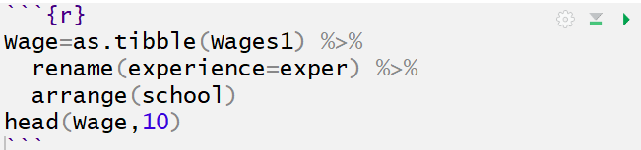
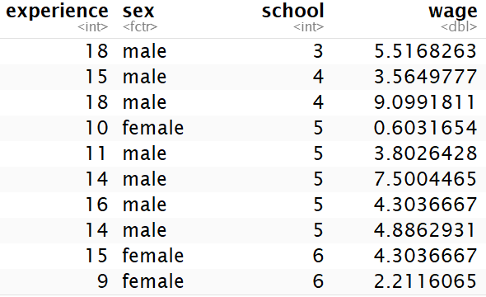
Data
Verbeek, Marno (2004) A Guide to Modern Econometrics, John Wiley and Sons.

Slide 5
Question
Think Creatively
Quantity and Quality
General:
What type of variation occurs within my variables?
What type of covariation occurs between my variables?

Slide 6
Question
Variation
Variable = Quantity, Quality, or Property You Can Measure
Reason: Values Tend to “Vary”
Example: Random
Categorical:
Eye Color
Occupation
Numerical:
Salary
Hair Count

Slide 7
Question
Initial Questions
Example: Random
Which Eye Color Occurs Most Often?
Are Salaries Skewed?
Where is the Middle 50% of the Sample in Regards to Hair Count?
Example: Wages
What did the Workforce Look Like in Terms of Sex?
How Spread Out Were Wages in 1987?

Slide 8
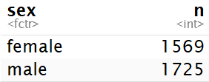
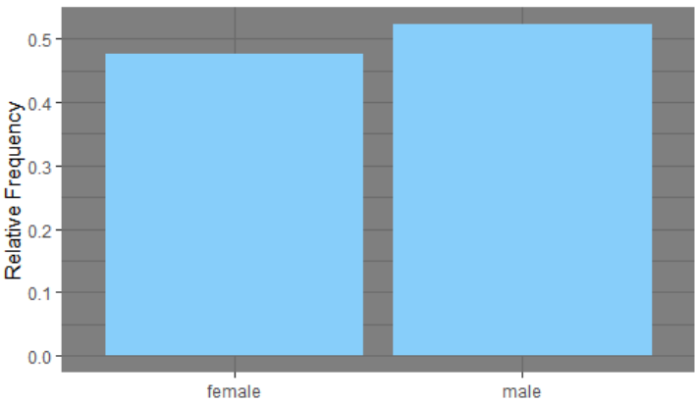
Visualize Summarize
Variation Visualized
Example: Wages
Categorical: Sex

Slide 9

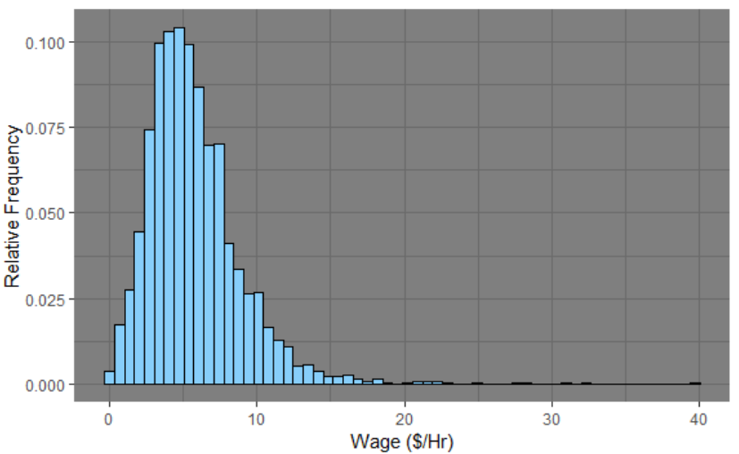
Visualize Summarize
Variation Visualized
Example: Wages
Numerical: Hourly Wage

Slide 10
Unusual Values
Outliers = Observations Outside the Pattern of the Data
Due to Error Remove
Don’t Drop or Change Without Justification
Sensitivity Analysis
Handling:
Drop Entire Row
Replace Instance with NA
Problems:
Book: Visualization
Other: Inference

Slide 11


Unusual Values
Example: Wages
Few People Above 30 $/Hr
Drop Entire Row
Observations: 3294 3291
Replace Instance with NA
Observations: 3294 3294

Slide 12
Question
Covariation
Goal: Explain Variation
Describes the Behavior Between Variables
We Often Attempt to Explain Variation Within by Looking at Covariation Between
Identify the Signal despite the Noise

Slide 13
Question
More Questions
Example: Random
Are there Occupations with an Unusual Distribution of Eye Color?
Does Occupation Affect Salary?
What is the Relationship Between Salary and Hair Count?
Example: Wages

Slide 14
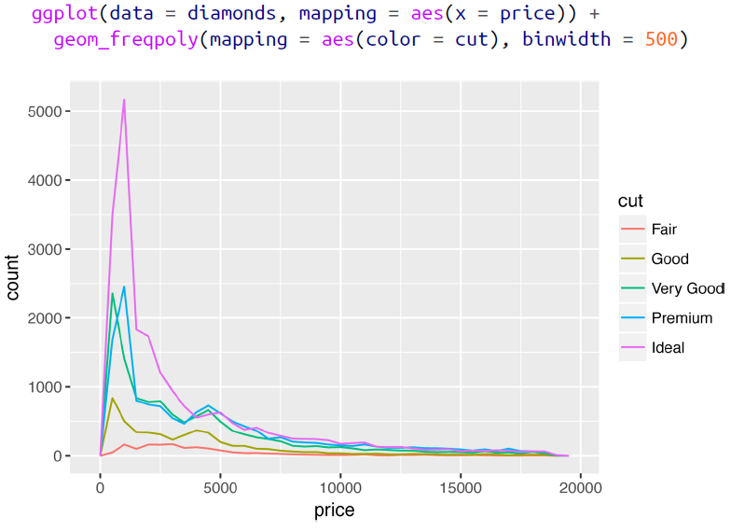
Visualize Summarize
Categorical and Numeric

Slide 15
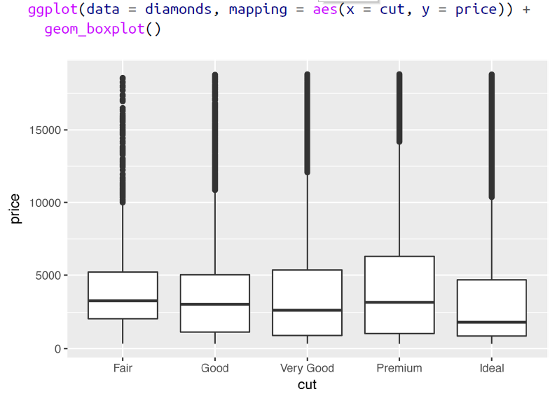
Visualize Summarize
Categorical and Numeric

Slide 16
Visualize Summarize
Categorical and Numeric

Slide 17
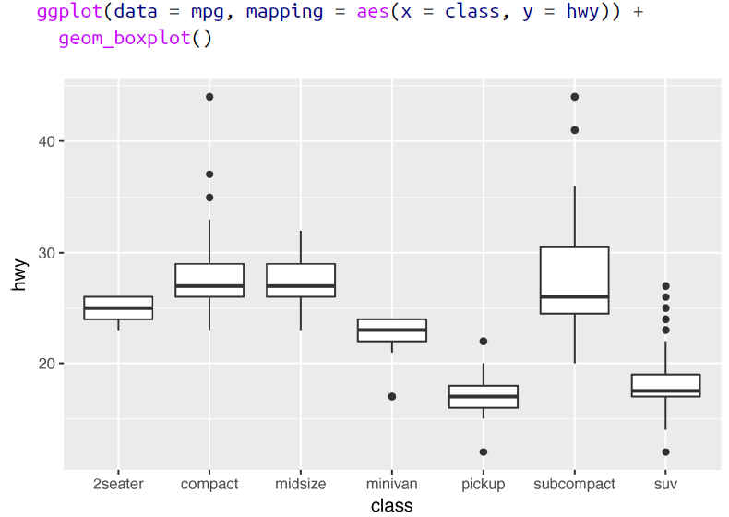
Visualize Summarize
Categorical and Numeric

Slide 18
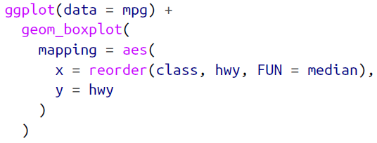
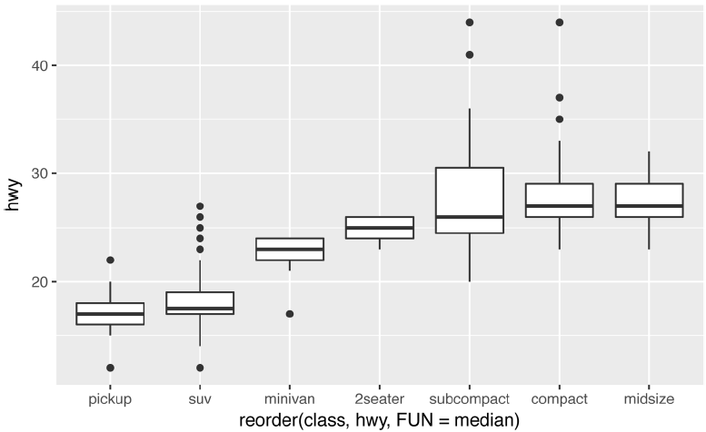
Visualize Summarize
Categorical and Numeric

Slide 19
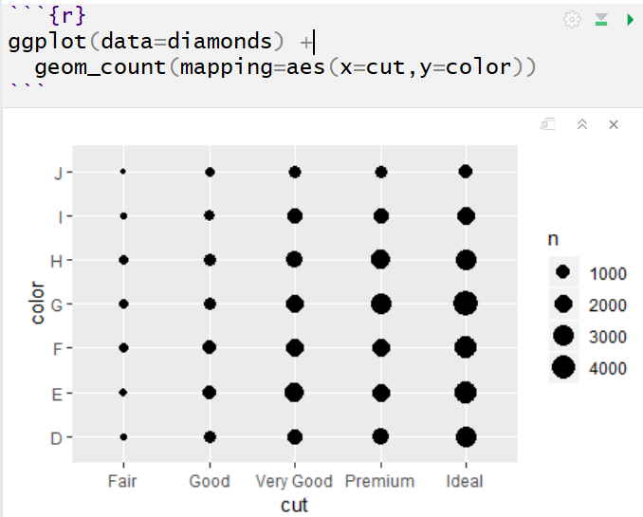
Visualize Summarize
Categorical and Categorical

Slide 20
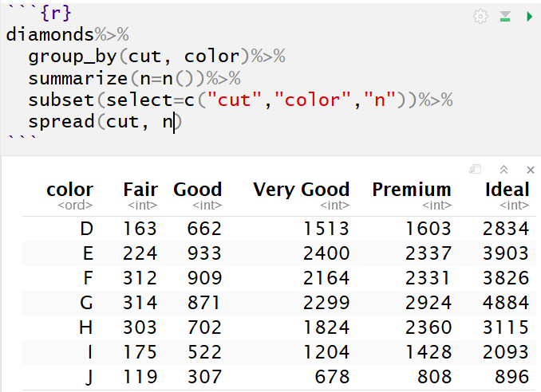
Visualize Summarize
Categorical and Categorical

Slide 21
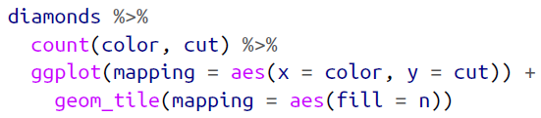
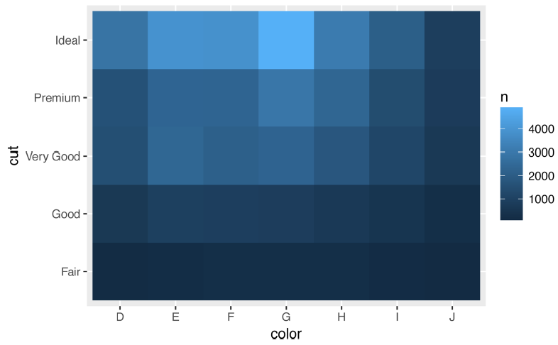
Visualize Summarize
Categorical and Categorical

Slide 22
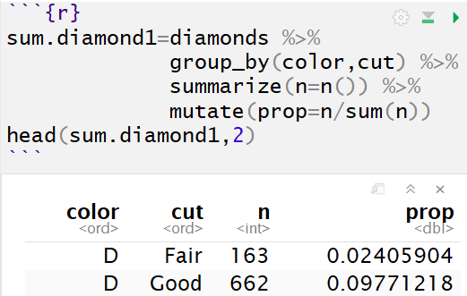
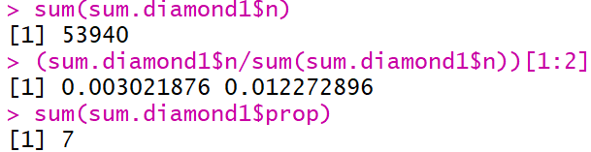
Visualize Summarize
Categorical and Categorical

Slide 23
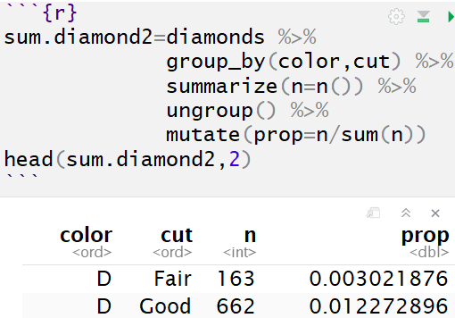
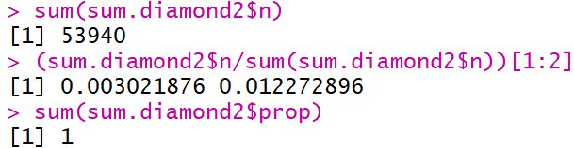
Visualize Summarize
Categorical and Categorical

Slide 24
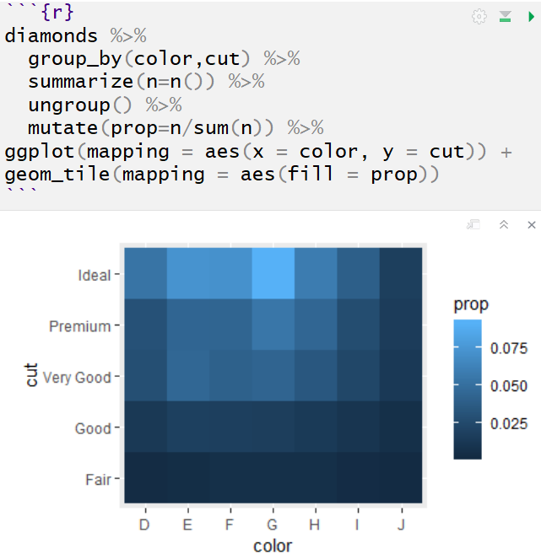
Visualize Summarize
Categorical and Categorical

Slide 25
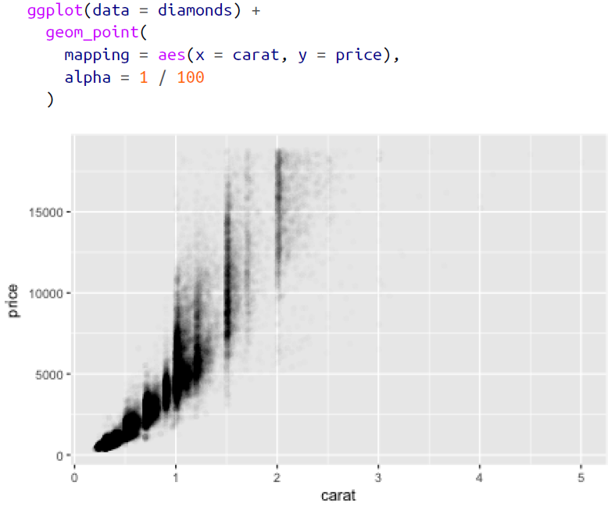
Visualize Summarize
Numerical and Numerical

Slide 26
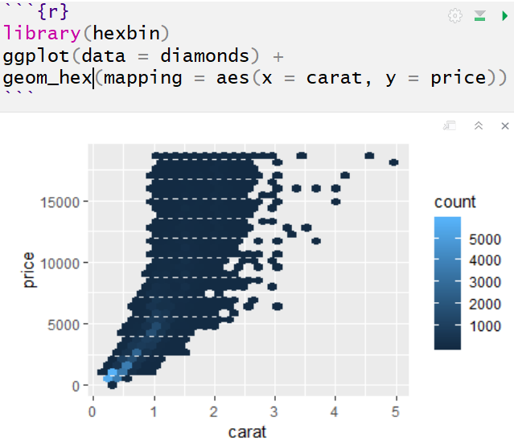
Visualize Summarize
Numerical and Numerical

Slide 27
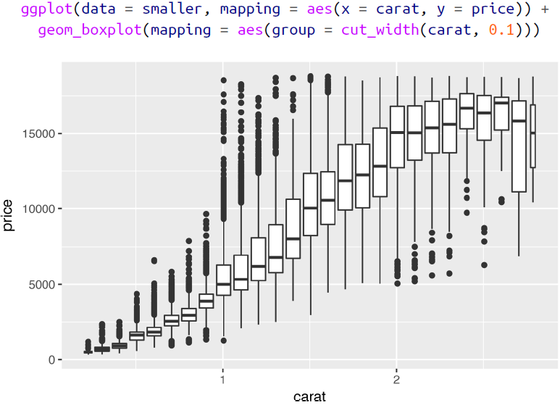
Visualize Summarize
Numerical and Numerical

Slide 28
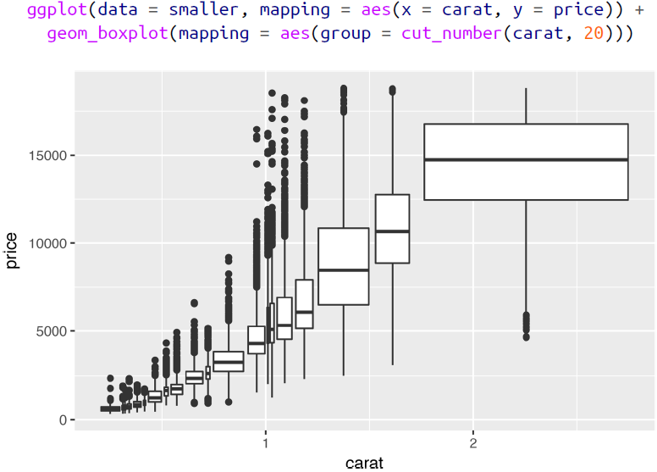
Visualize Summarize
Numerical and Numerical

Slide 29
Closing
Disperse and Make Reasonable Decisions

